Slide 1


Informatica Data Quality Classifier Model

Slide 2
Task 1 : Create New Physical Data Object ➔ ProductLang

Slide 3
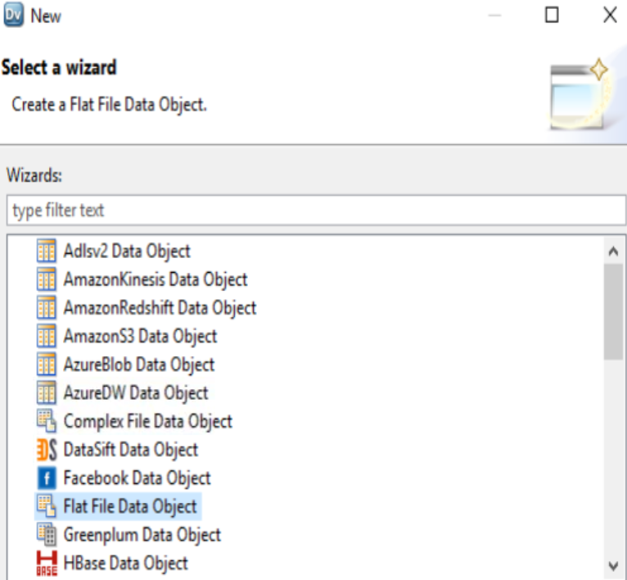
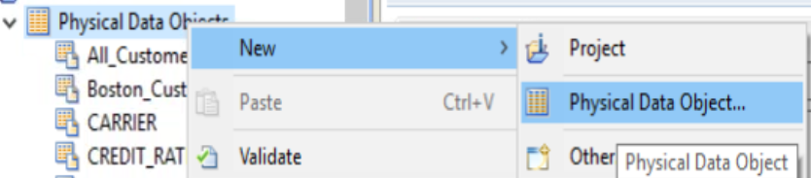
Step 1 : Create New Physical Data Objects

Slide 4
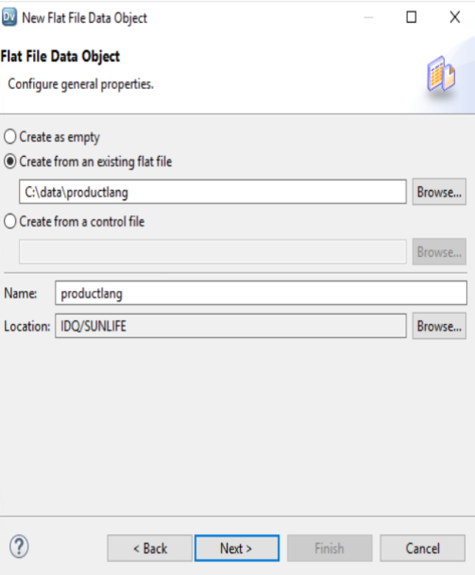
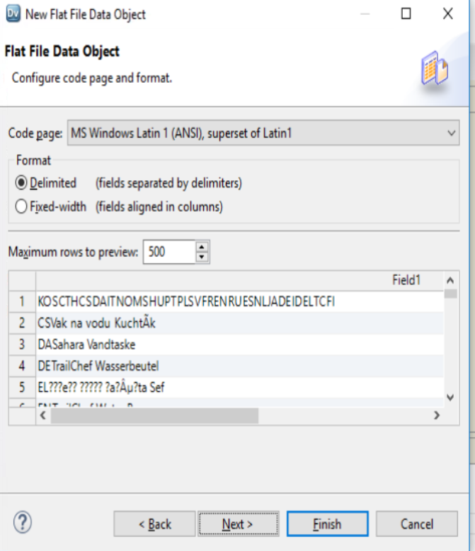
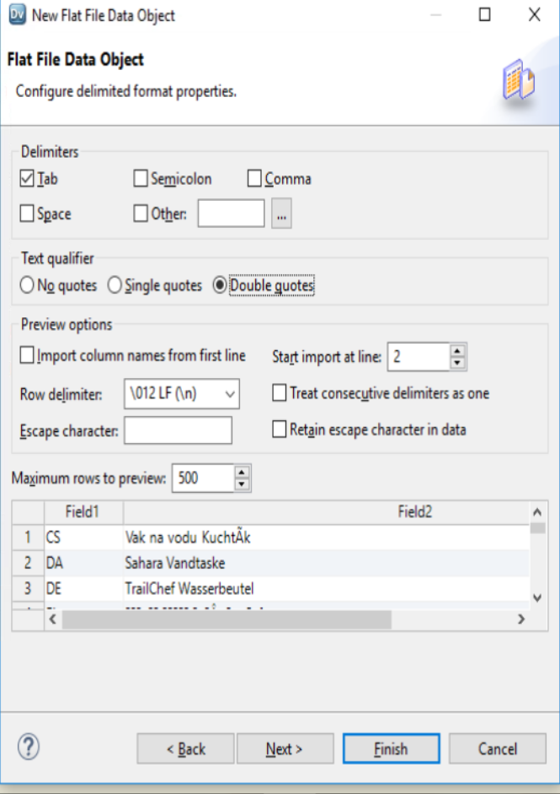
Step 2 : Create New Physical Data Objects , Name : PRODUCTLANG Delimited = Format, START Import at line ➔ 2

Slide 5
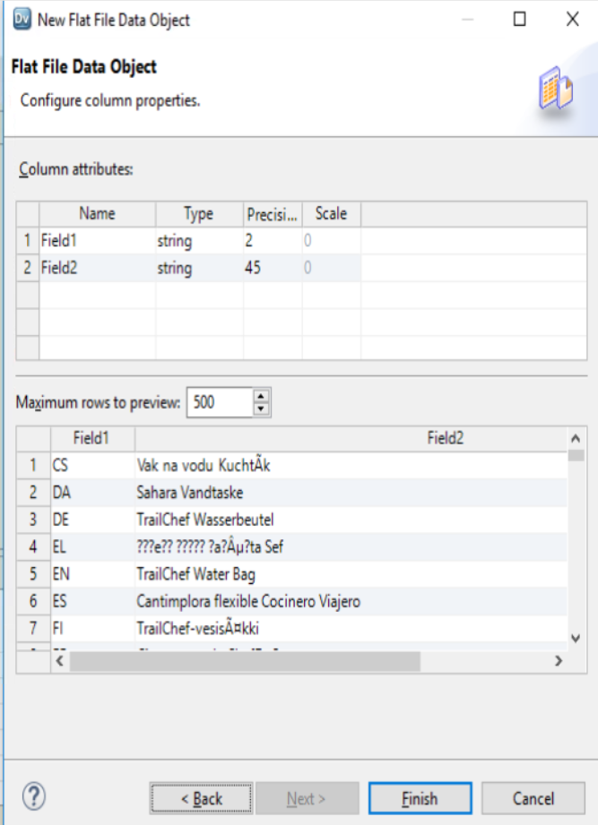
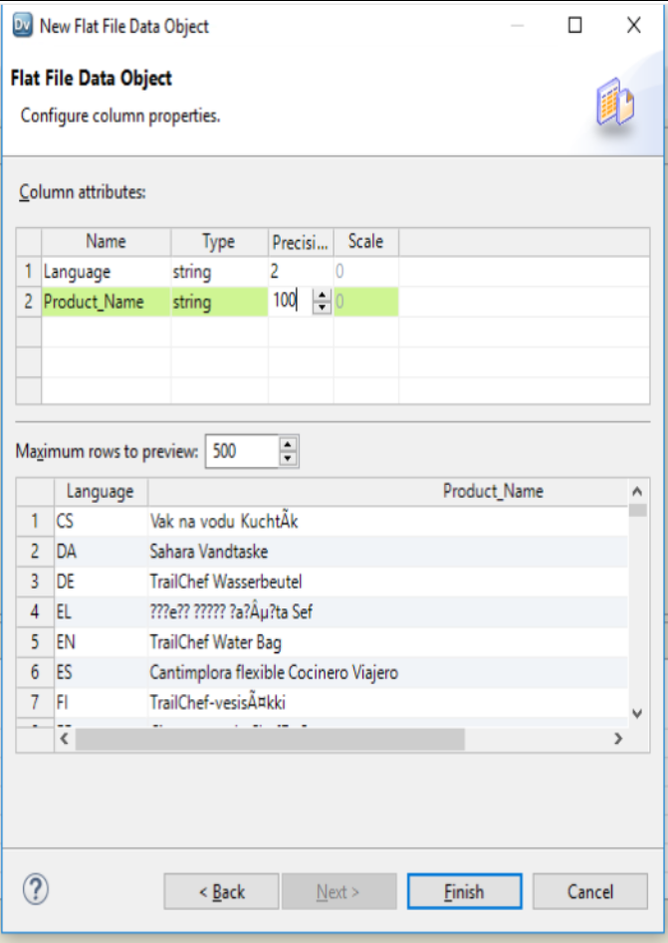
Step 2 : Create New Physical Data Objects , Name : PRODUCTLANG

Slide 6
Task 2 : Create New Physical Data Object ➔ ProductName

Slide 7
Step 1 : Create New Physical Data Objects

Slide 8
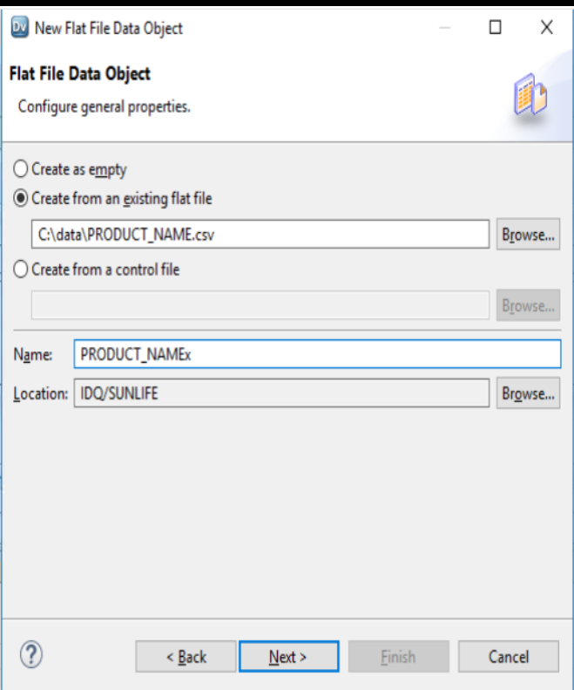
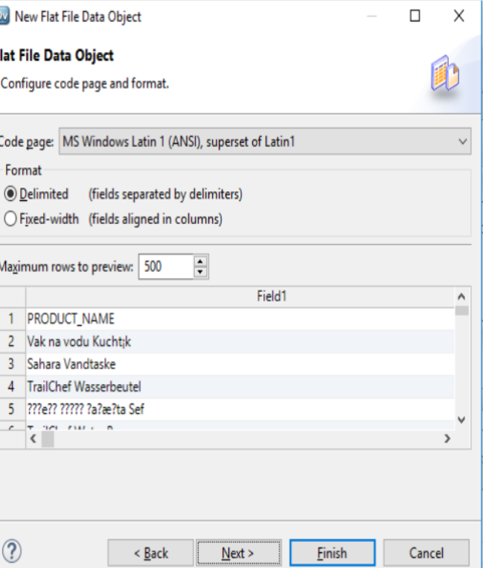
Step 2 : Create New Physical Data Objects , Name : PRODUCT_NAME.csv Delimited = Format

Slide 9
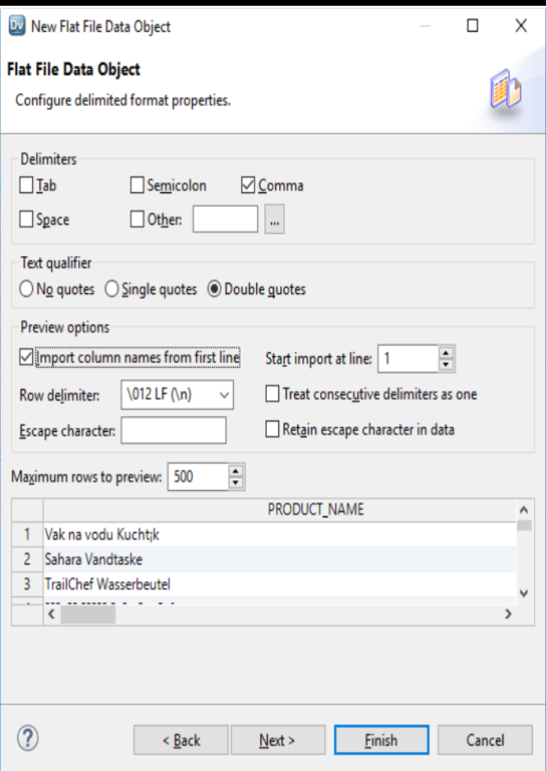
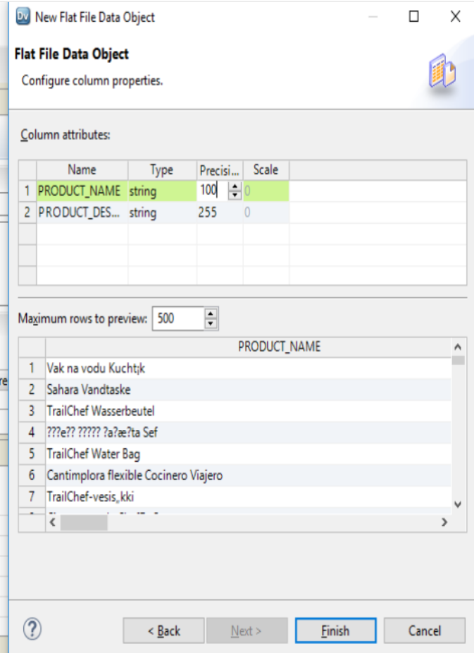
Step 3 : Create New Physical Data Objects
Delimiter = Comma Text Qualifier ➔ Double Quotes , Column Name ➔ PRODUCT_NAME ,string 100 , product_Desc string 255 ➔ Click Finish

Slide 10
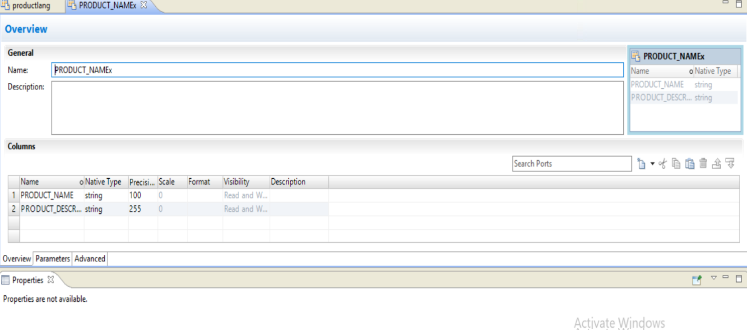

Slide 11
Task 3 : Open Content Set and Add Classifier Model

Slide 12
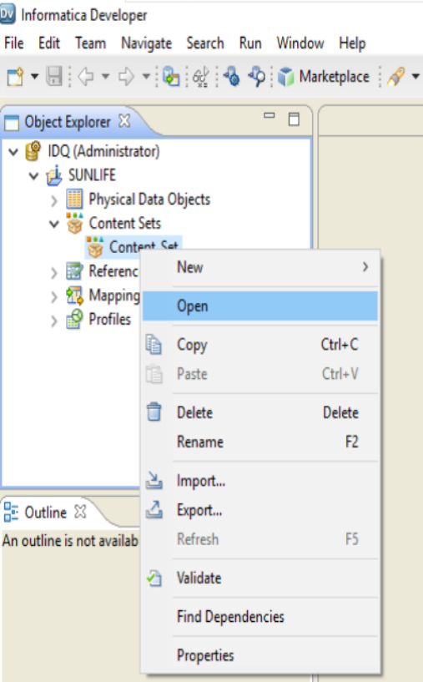
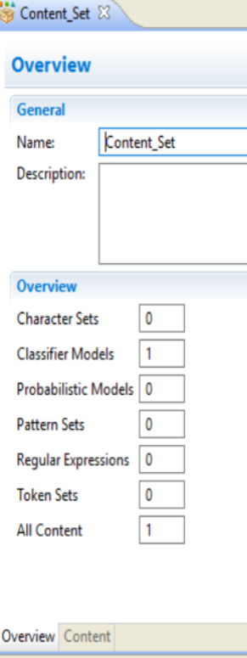
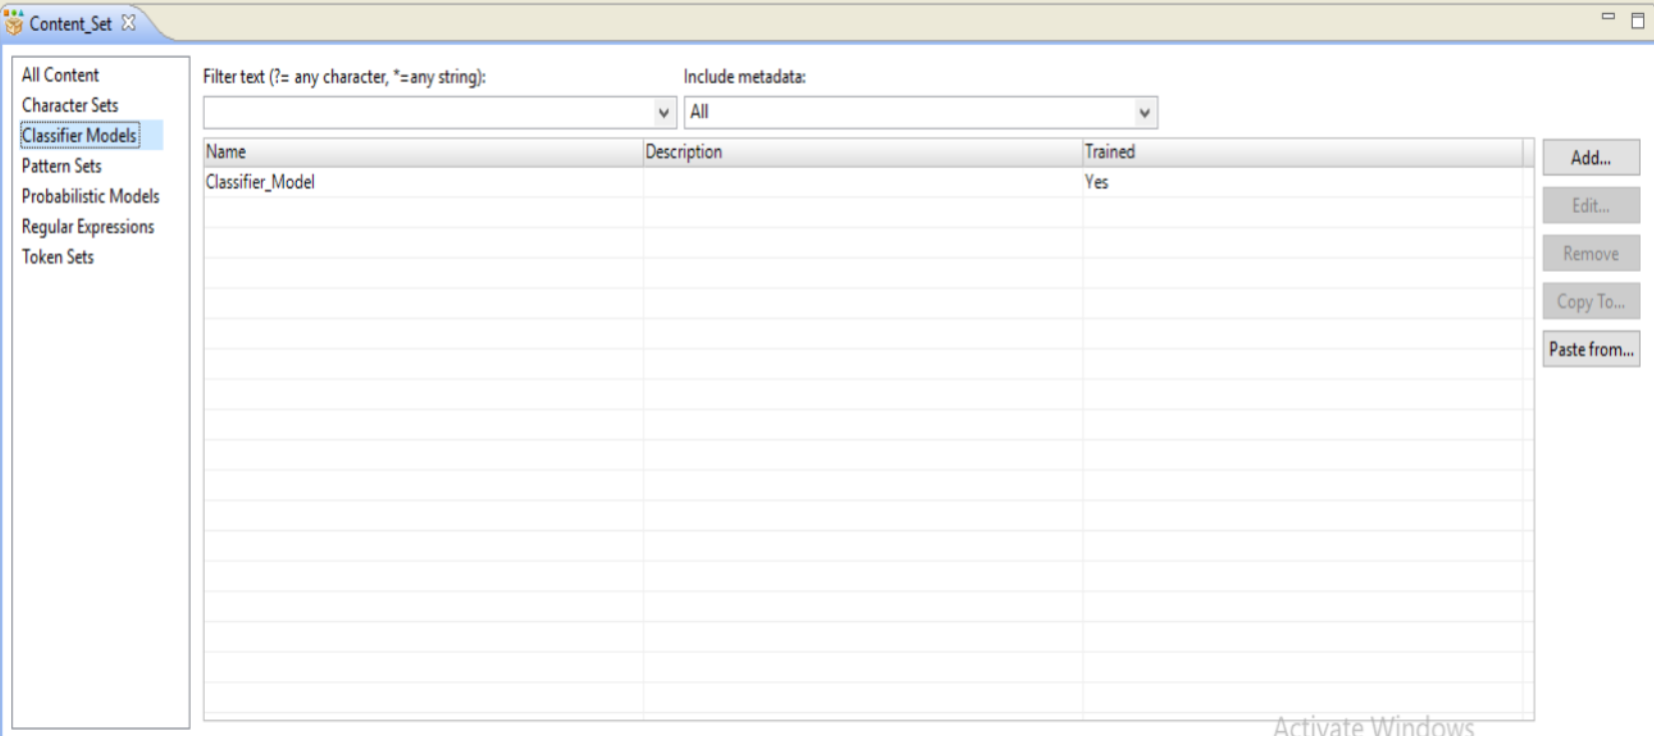
Step 1 : Open Content Set
Open Content Set ➔ Choose Content ➔ Classifier Models ➔ CLICK ADD MODEL

Slide 13
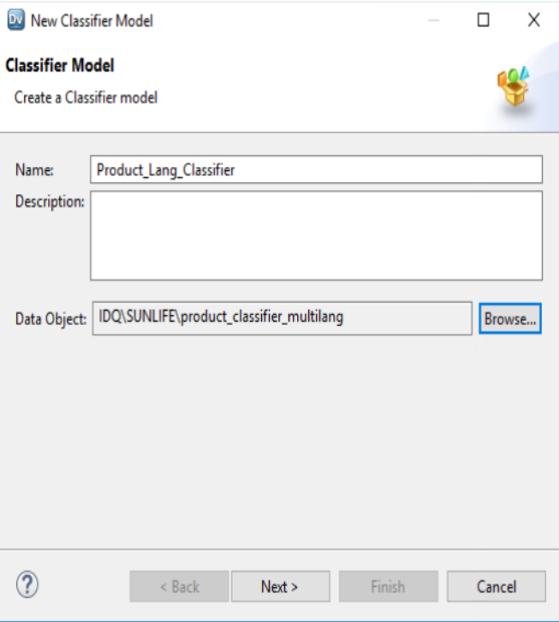
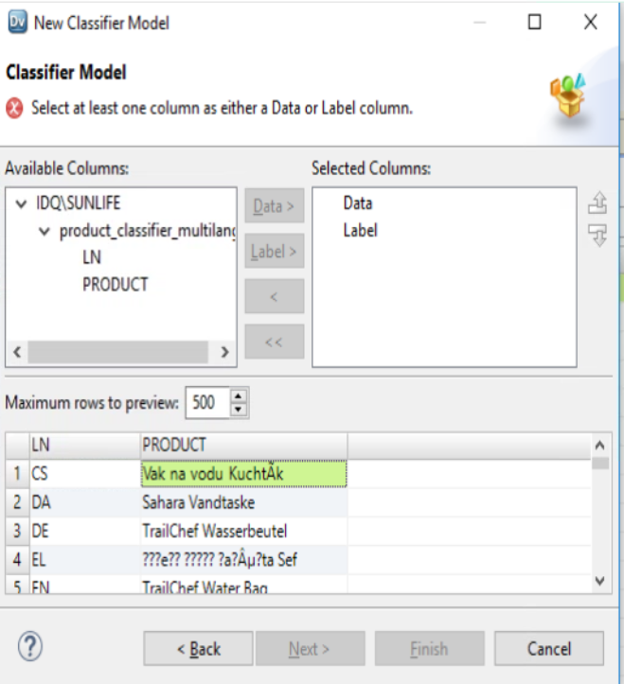
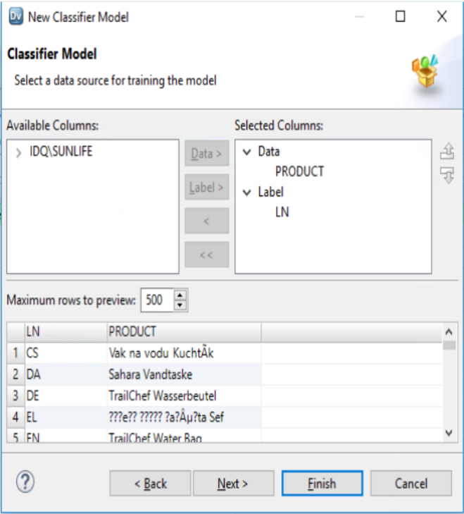
Step 1 : Add Classifier Model
Name Content Set ➔ Product_Lang_Classifier
LN ➔ LABEL , PRODUCT➔ DATA
Click Finish

Slide 14
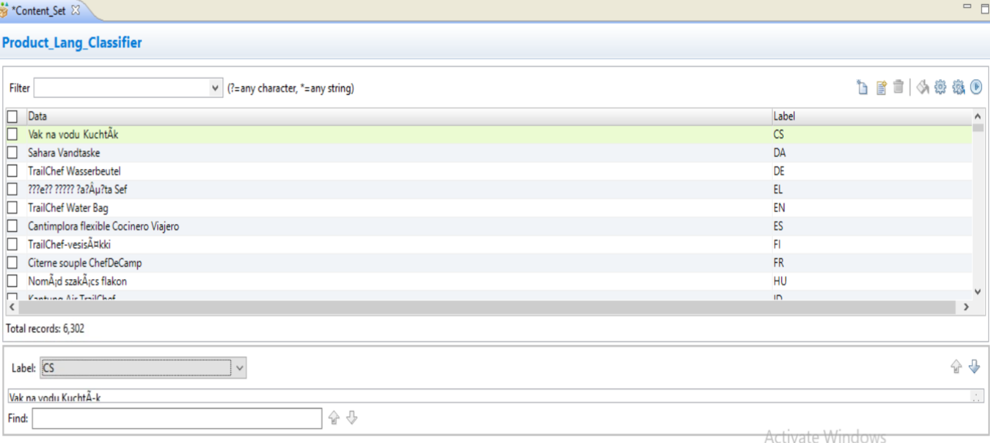
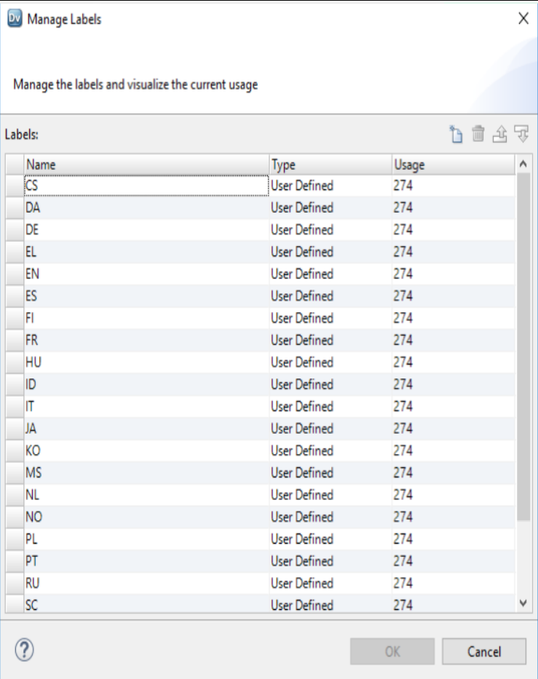
Step 1 : Configure Classifier Model
MANAGE LABELS

Slide 15
Task 4 : Save and Compile Classifier Model

Slide 16
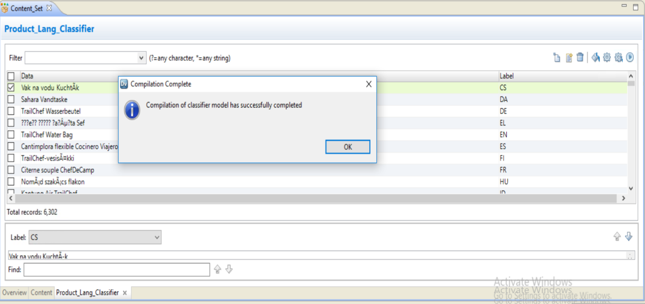
Step 1 : Classifier Model
CTRL + S ➔ SAVE
ONCE IT IS SSAVED PRESS COMPILE BUTTON

Slide 17
Task 5 : Create New Mapping to Test Classifier Model

Slide 18
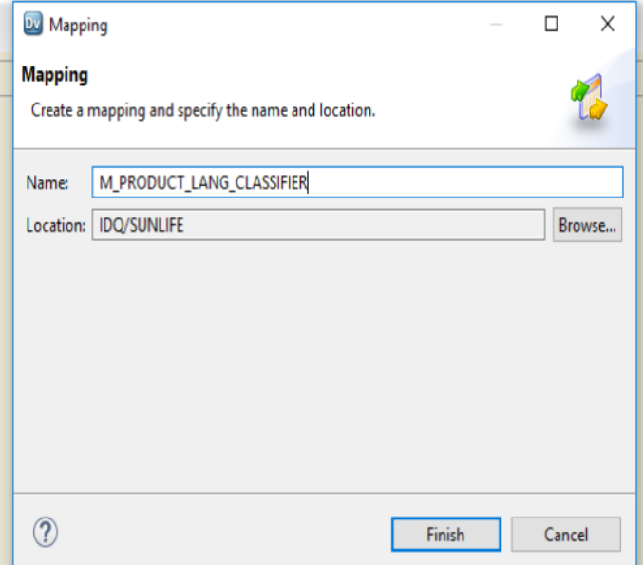
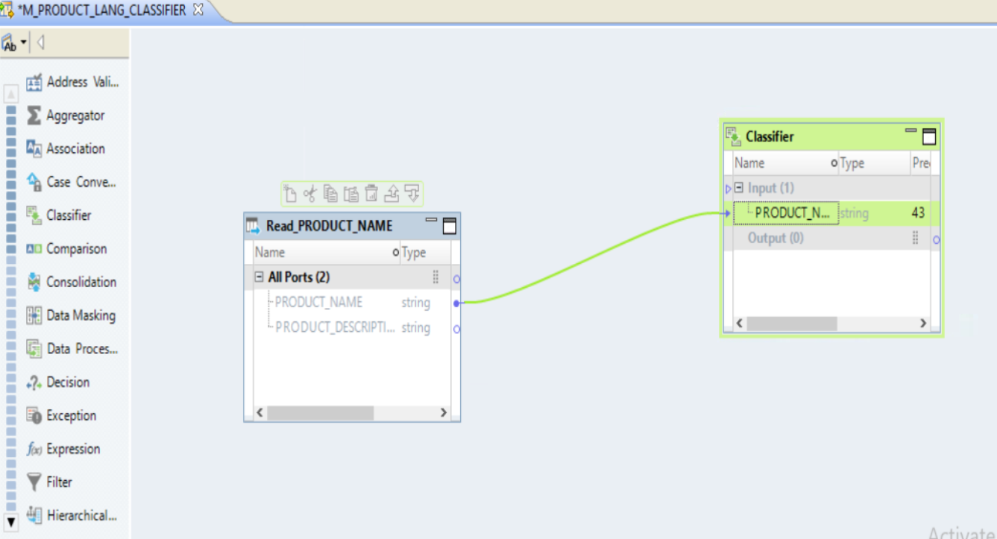
Step 1 : Create New Mapping
ADD SOURCE ➔ PRODUCT_NAME (READ )
ADD TRANSFORMATION ➔ CLASSIFIER
Move PRODUCT_NAME FIELD FROM SOURCE TO CLASSIFIER iNPUT
Name : M_PRODUCT_LANG_cLASSSIFER

Slide 19
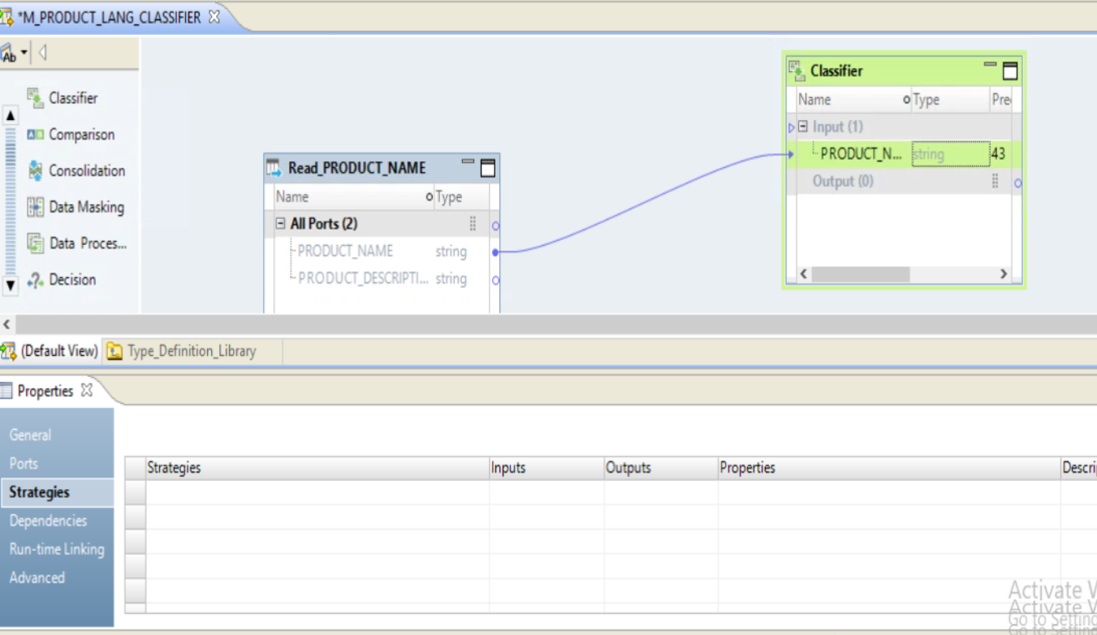
Step 1 : Classifier
Open Content Set
CLASSSIFER ➔ RIGHT CLICK ➔ PROPERTIES

Slide 20
Task 6 : Configure Classifier Model

Slide 21
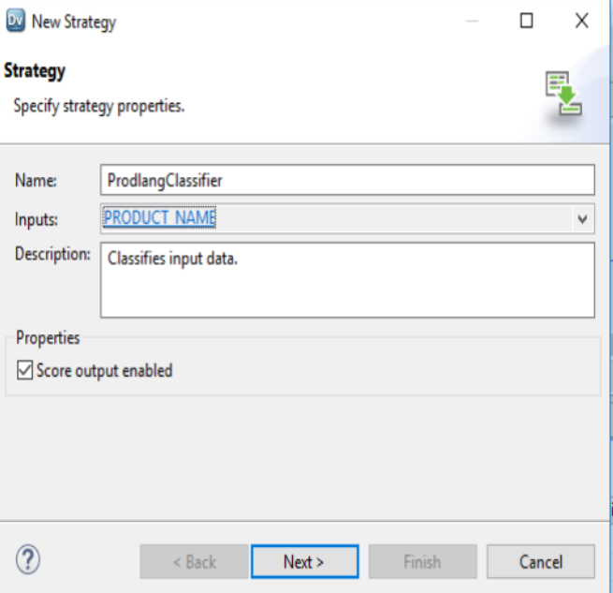
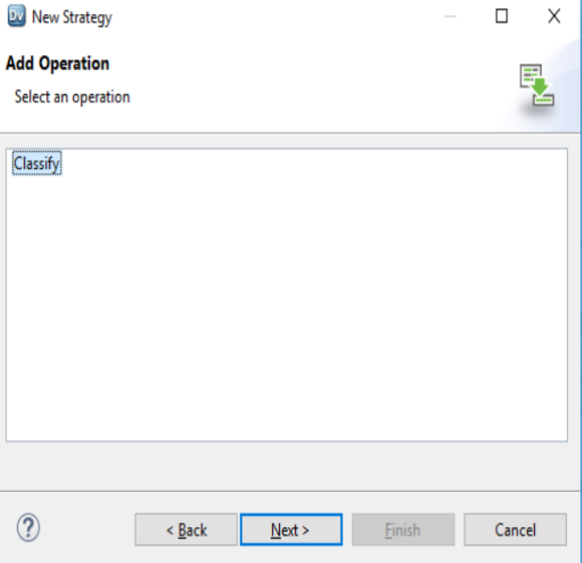
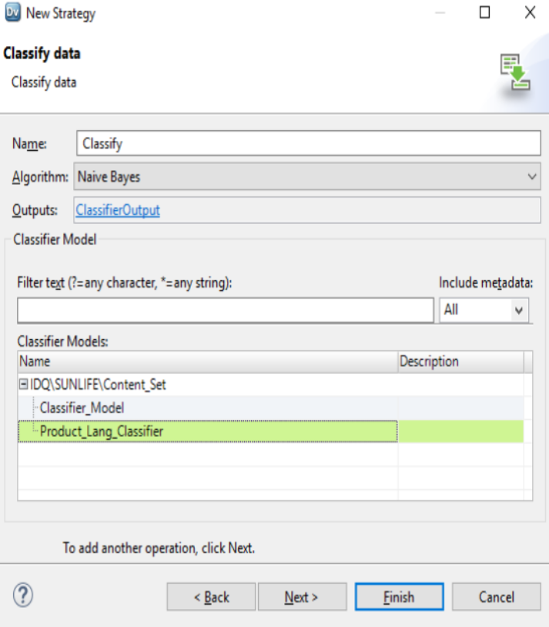
Step 1 : Classifier Transformation
Name: Classify
Algorithm : Naïve Byes
Output ➔ ClassifierOutput
Classifier Model : Product_lang_classifier
Create New Strategy
Name : Product Classisfier
Input ➔ PRODUCT_NAME
ADD Operation : Classify

Slide 22
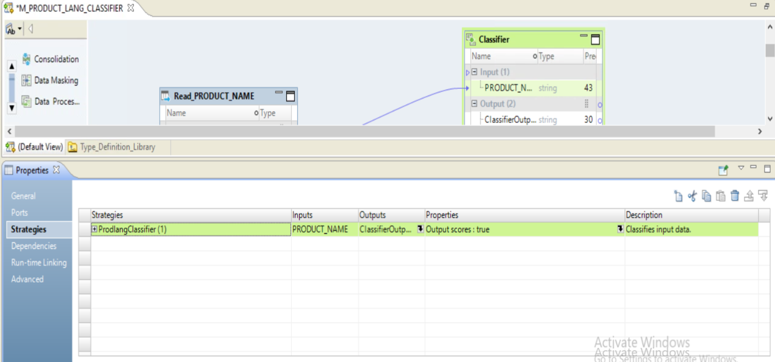
Step 1 : Classifier
Classifier Properties ➔ Strategy

Slide 23
Task 6 : Run Data Viewer

Slide 24
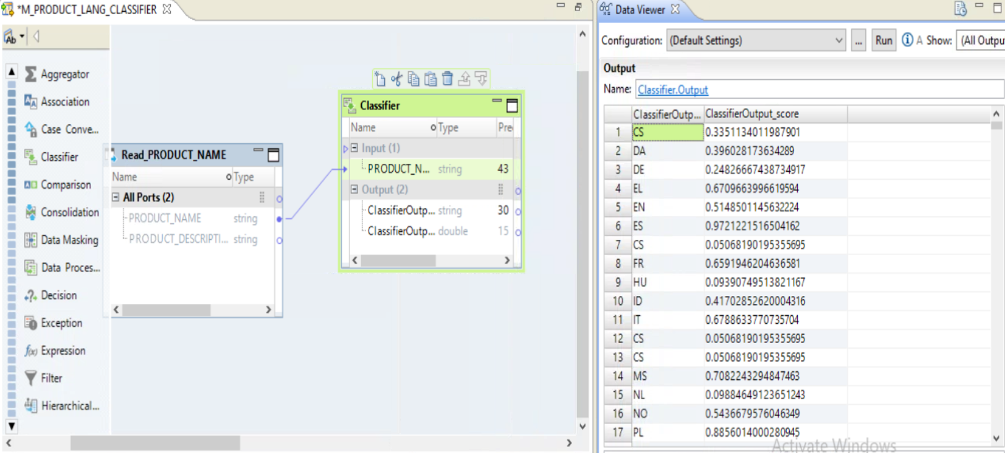
RUN DATA VIEWER

Slide 25
Task 6 : Change Algorithm from navie bayes ➔ entropy

Slide 26
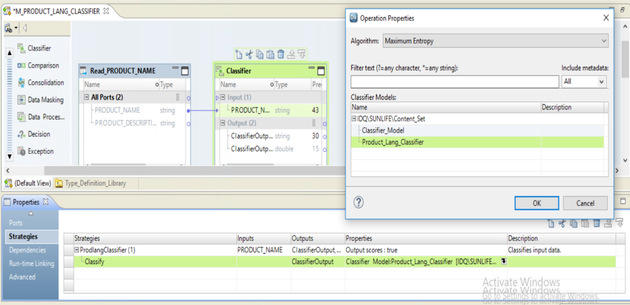
Step 1 : Classifier Tranformation ➔ change Algorithm : Maximum Entropy
Open Content Set

Slide 27
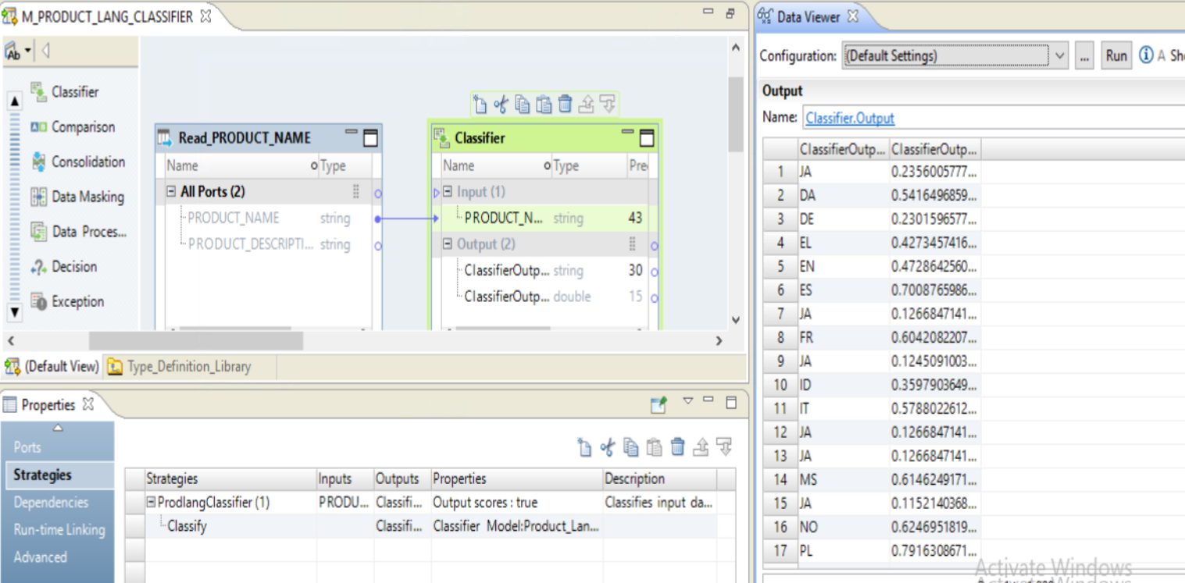
Open Content Set

